Slide 1
Databases 4
DB & SQL Recap
Pt1
Ashley Cahill
ashley.cahill@tus.ie

Slide 2
Learning Outcomes
Recap RDBMS
Recap DDL
Recap DML

Slide 3
What Is A RDB?
Relational Database.
Database that stores and provides access to data points that are related to one another.
Relational Database Management System (RDBMS).
Software used to store, manage, query, and retrieve data stored in a relational database.

Slide 4
Installations
XAMPP
MySQL
MySQL Workbench

Slide 5
XAMPP
Developed in 2002.
XAMPP is an abbreviation for cross-platform, Apache, MySQL, PHP and Perl.
Free and open-source cross-platform web server solution stack package developed by Apache Friends.

Slide 6
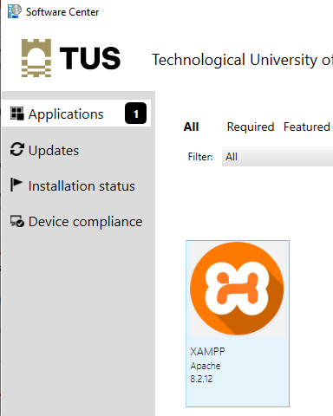
XAMPP Installation
www.apachefriends.org/download.html
Executable installer.
Available for Windows, Linux and OS X download/installation.
Also available for direct install on Software Centre in Labs

Slide 7
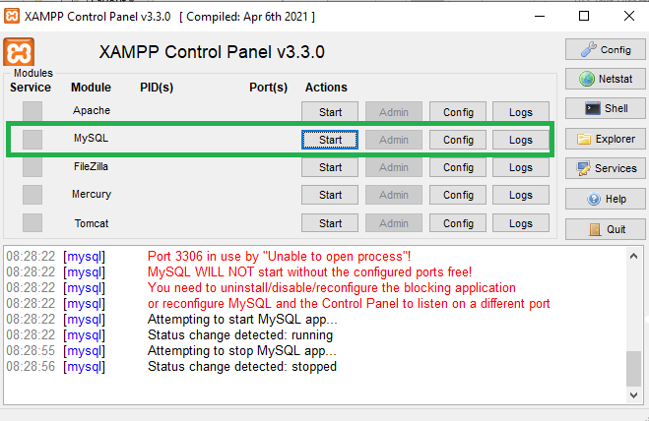
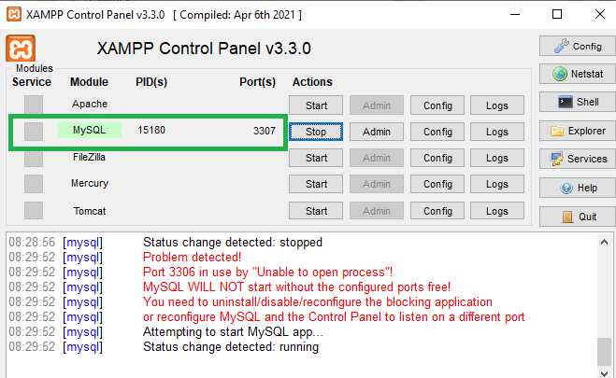
XAMPP Installation

Slide 8
XAMPP Installation
In some Labs … XAMPP may try to default to PORT 3306 and Fail.
In some Labs … PORT 3306 or PORT 3307 may be Blocked
If this happens, Open the ini file from the Config button and search for 3306, and update to 3307 (or vice versa depending on which is not working)

Slide 9
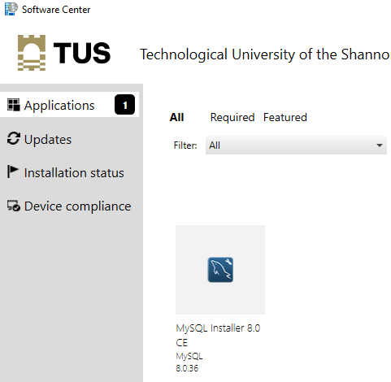
MySQL server/Workbench Installation
https://dev.mysql.com/downloads/
https://dev.mysql.com/downloads/workbench/
Also available for direct install on Software Centre in Labs
MySQL Installer

Slide 10
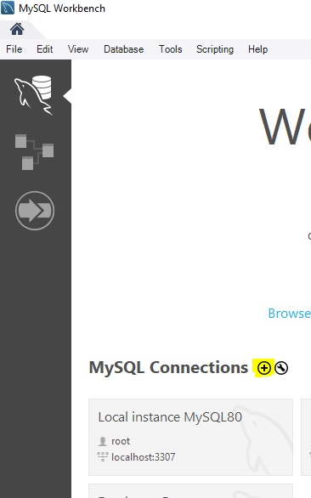
MySQL Workbench
Create a new Connection

Slide 11
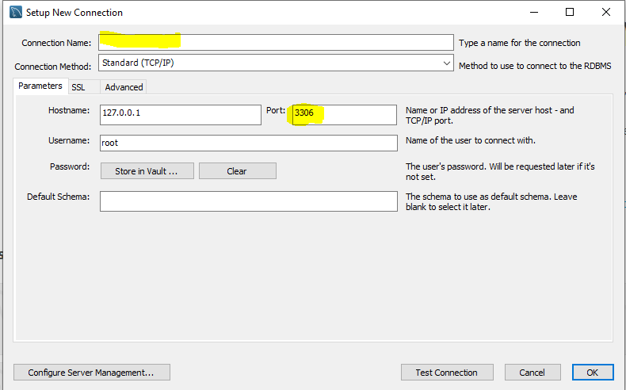
MySQL Workbench
Give it a meaningful name
Set the correct Port

Slide 12
SQL Recap
Structured Query Language
Originally called SEQUEL (Structured English Query Language)
Developed in 1970’s by Raymond Boyce and Donald Chamberlin (IBM).
Based on the Relational Model as described by Dr. E. F. Codd
"A Relational Model of Data for Large Shared Data Banks"

Slide 13
SQL Recap
Data Definition Language (DDL)
Create/Alter/Delete tables and their attributes
Data Manipulation Language (DML)
Query one or more tables
Insert/Delete/Update tuples in tables

Slide 14
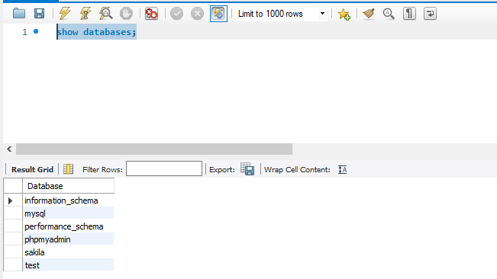
Getting Started
MySQL Workbench
SHOW DATABASES;

Slide 15
SQL Create Database
Syntax
DROP DATABASE IF EXISTS DB4_2024;
CREATE DATABASE IF NOT EXISTS DB4_2024;
USE DB4_2024;

Slide 16
Data Definition Language (DDL)
Data Definition Language (DDL) is a vocabulary used to define data structures (database schema) in SQL.
These statements are used to create, alter, or drop data structures in SQL.
CREATE
ALTER
DROP

Slide 17
SQL DDL Creation Syntax
Used to create tables, views, stored procedures, functions
Database Table is a structure used to store data

Slide 18
SQL DDL Creation Syntax
CREATE TABLE relation-name
(attribute-name domain
[, attribute-name domain ]*);

Slide 19
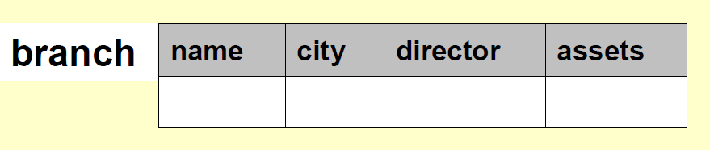
SQL DDL Creation Example
CREATE TABLE branch ( name varchar(10),
city varchar(20),
director varchar(20),
assets integer);

Slide 20
SQL DDL Creation Example
CREATE TABLE FoodTable ( food varchar(10),
price DECIMAL(5,2),
qty INTEGER);

Slide 21
SQL DDL DESC
DESC used to describe a table
Syntax
DESC branch;

Slide 22
SQL DDL Deletion Syntax
DROP TABLE relation_name;
DROP TABLE FoodTable;

Slide 23
SQL DDL Alter Syntax
Used to add, delete, or modify columns in an existing table.
Can also be used to add or drop constraints on an existing table.

Slide 24
SQL DDL Alter Syntax
To add a column:
ALTER TABLE relation_name
ADD COLUMN Att_name DataType;
To remove a column :
ALTER TABLE relation_name
DROP COLUMN Att_name;

Slide 25
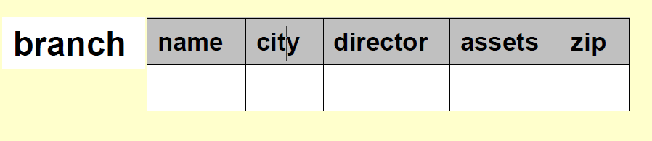
SQL DDL Alter Example
ALTER TABLE branch ADD COLUMN zip INTEGER;
becomes
becomes

Slide 26
SQL DDL Alter Example
ALTER TABLE branch DROP COLUMN zip;
becomes
Notes:
Use DESC to see changes

Slide 27
Data Manipulation Language (DML)
Data manipulation language comprises the SQL data change statements, which modify stored data but not the schema or database objects.

Slide 28
Data Manipulation Language (DML)
INSERT INTO … VALUES …
SELECT … FROM …WHERE …

Slide 29
DML - INSERT
Used to insert values into tables
Specify the table, columns (optional) and data

Slide 30
Data Manipulation Language (DML)
INSERT INTO … VALUES …

Slide 31
DML – INSERT Syntax
INSERT INTO
<table name>
VALUES
<value list>;

Slide 32
DML – INSERT Example
To insert a row into a table, it is necessary to have a value for each attribute, and order matters.
INSERT INTO branch VALUES (’branch 1’, ‘Athlone’, ‘J.Blogg’,70 ); INSERT INTO branch VALUES (’branch 2’, ‘Ballinasloe’, ‘Pat Mc’,500 );
name | city | director | Assets
branch 1 | Athlone | J. Bloggs | 70
branch 2 | Ballinasloe | Pat Mc | 500

Slide 33
DML – INSERT Example
To insert a row into a table, it is necessary to have a value for each attribute, and order matters.
INSERT INTO branch VALUES (’branch 3’, ‘Dublin’, ‘J.Public’,15 );
name | city | director | Assets
branch 1 | Athlone | J. Bloggs | 70
branch 2 | Ballinasloe | Pat Mc | 500
Becomes
name | city | director | Assets
branch 1 | Athlone | J. Bloggs | 70
branch 2 | Ballinasloe | Pat Mc | 500
branch 3 | Dublin | J. Public | 15

Slide 34
DML - INSERT
If you are not inserting value into all columns, you must specify columns
INSERT INTO branch (name, city, director) VALUES (‘branch 4’, ‘Mullingar’, ‘J.Dolan’);
INSERT INTO branch (name, city, director, assets) VALUES (‘branch 5’, ‘Athlone’, ‘D.Dolan’, 15);
INSERT INTO branch (name, city, director) VALUES (‘branch 6’, ‘Roscommon’, ‘D.Dolan’);

Slide 35
Data Manipulation Language (DML)
SELECT … FROM …WHERE …

Slide 36
DML - SELECT
Used to retrieve records from Database
Specify the required data, data source and any conditions/criteria
Six operations of the SELECT statement
SELECT
FROM
WHERE
GROUP BY
HAVING
ORDER BY

Slide 37
DML – SELECT Syntax
SELECT
column_name(s) FROM
table_name
WHERE
condition
GROUP BY grouping
HAVING grouping_filter ORDER BY column_name(s) ASC|DESC

Slide 38

DML – LIKE Operator
Used with a WHERE Clause for pattern matching on strings
Syntax
SELECT * FROM branch WHERE city LIKE ‘%lon%’ ;
Pattern may contain two special symbols:
% = any sequence of characters … zero or more
_ = any single character

Slide 39
DML – LIKE - Pattern
Differences in Database Systems patterns
MySQL/ORACLE/SQL SERVER
%
_
MS Access
asterisk (*) any sequence of characters
question mark (?) any single character

Slide 40
DML – DISTINCT
DISTINCT keyword used to eliminate Duplicates
Returns the distinct values based on column list provided

Slide 41


DML – DISTINCT
SELECT city FROM branch;
SELECT DISTINCT city FROM branch;

Slide 42
DML – ORDER BY Keyword
Used to sort the result-set by a specified column.
The ORDER BY keyword sort the records in ascending (ASC) order by default.
To sort the records in a descending order, you can use the DESC keyword

Slide 43
DML – ORDER BY Keyword
SQL ORDER BY Syntax:
SELECT column_name(s) FROM table_name ORDER BY column_name(s) ASC|DESC

Slide 44
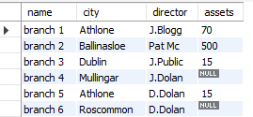
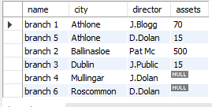
DML – ORDER BY Keyword
“branch" table:
SELECT * FROM branch ORDER BY City;

Slide 45
SQL Scalar functions
SQL scalar functions return a single value, based on the input value.
Useful scalar functions:
UCASE() - Converts a field to upper case
LCASE() - Converts a field to lower case
LENGTH() - Returns the length of a text field
ROUND() - Rounds a numeric field to the number of decimals specified
NOW() - Returns the current system date and time

Slide 46
SQL Scalar functions
SELECT UCASE(City) FROM branch order by city;
SELECT length(city) from branch;

Slide 47
SQL Aggregate Functions
SQL has many built-in functions for performing calculations on data.
SQL Aggregate Functions return a single value, calculated from values in a column.
Useful aggregate functions:
AVG() - Returns the average value
COUNT() - Returns the number of rows
SUM() - Returns the sum
MAX() – Returns Maximun
MIN() – Returns Minimum

Slide 48
SQL Aggregate Functions
SELECT COUNT(assets) FROM branch;
SELECT SUM(assets) FROM branch;
SELECT AVG(assets) FROM branch;

Slide 49
SQL Summarising Data
The GROUP BY clause groups the rows of a result set based on one or more columns or expressions.
Syntax
SELECT column_name, aggregate_function(column_name) FROM table_name WHERE condition GROUP BY column_name;

Slide 50
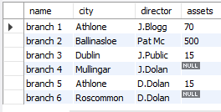
SQL Summarising Data
Example: Summarise the branch table

Slide 51
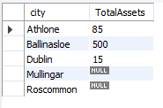
SQL Summarising Data
SELECT city, SUM(assets) AS TotalAssets FROM branch GROUP BY city;

Slide 52
SQL Group By
If you include 2 or more columns or expressions in the GROUP BY clause, they will form a hierarchy where each column or expression is subordinate to the previous one.

Slide 53
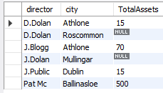
SQL Group By
SELECT director, city, SUM(assets) AS TotalAssets FROM branch GROUP BY director,city;

Slide 54
SQL Group By…Having
The GROUP BY clause determines how the selected rows are grouped, and the HAVING clause determines which groups are included in the final results.

Slide 55

SQL Group By…Having
SELECT director, city, SUM(assets) AS TotalAssets FROM branch GROUP BY director,city;
SELECT director,city, SUM(assets) AS TotalAssets FROM branch GROUP BY director,city HAVING SUM(assets) >15;

Slide 56
SQL Group By … ROLLUP
You can use the WITH ROLLUP operator in the GROUP BY clause to add summary rows to the final result set.

Slide 57
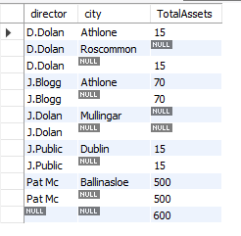
SQL Group By … ROLLUP
SELECT director,city, SUM(assets) AS TotalAssets
FROM branch
GROUP BY director,city
WITH ROLLUP;

